Slide 1
ARTIFICIAL NEURAL NETWORK

Slide 2
WHAT IS ANN ?
AN ARTIFICIAL NEURAL NETWORK (ANN) IS A COMPUTATIONAL MODEL INSPIRED BY THE STRUCTURE AND FUNCTIONING OF THE HUMAN BRAIN'S NEURAL NETWORKS. IT CONSISTS OF INTERCONNECTED NODES, CALLED NEURONS, ORGANIZED INTO LAYERS. THESE LAYERS TYPICALLY INCLUDE AN INPUT LAYER, ONE OR MORE HIDDEN LAYERS, AND AN OUTPUT LAYER.ANN HAVE BEEN WIDELY USED IN VARIOUS FIELDS, INCLUDING MACHINE LEARNING, PATTERN RECOGNITION, COMPUTER VISION, NATURAL LANGUAGE PROCESSING, AND MANY OTHERS

Slide 3
SEVERITY PREDICTION OF TRAFFIC ACCIDENT USING AN ARTIFICIAL NEURAL NETWORK
This is a countrywide car accident dataset that covers 49 states of the USA. The accident data were collected from February 2016 to March 2023, using multiple APIs that provide streaming traffic incident (or event) data. These APIs broadcast traffic data captured by various entities, including the US and state departments of transportation, law enforcement agencies, traffic cameras, and traffic sensors within the road networks. We have taken 4000 rows for our project
Journal_of_Forecasting_-_2016_-_Alkheder_-_Severity_Prediction_of_Traffic_Accident_Using_an_Artificial_Neural_Network[1].pdf

Slide 4
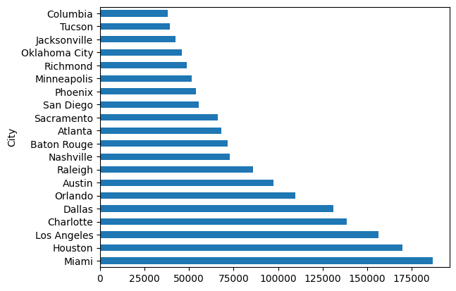
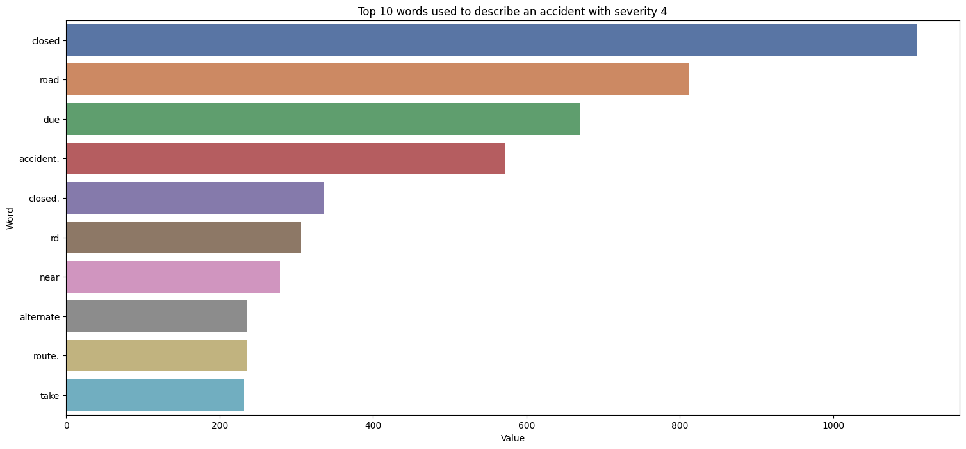
STATISTICS

Slide 5
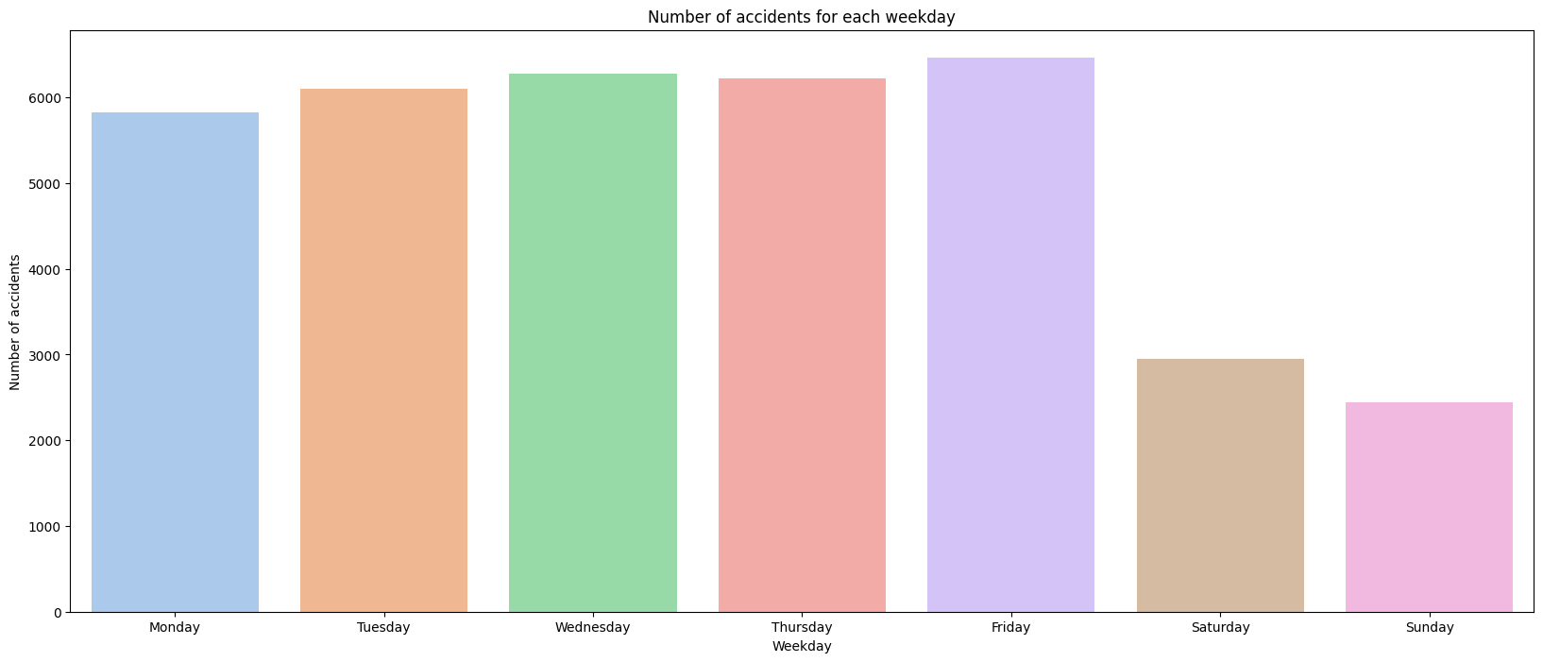
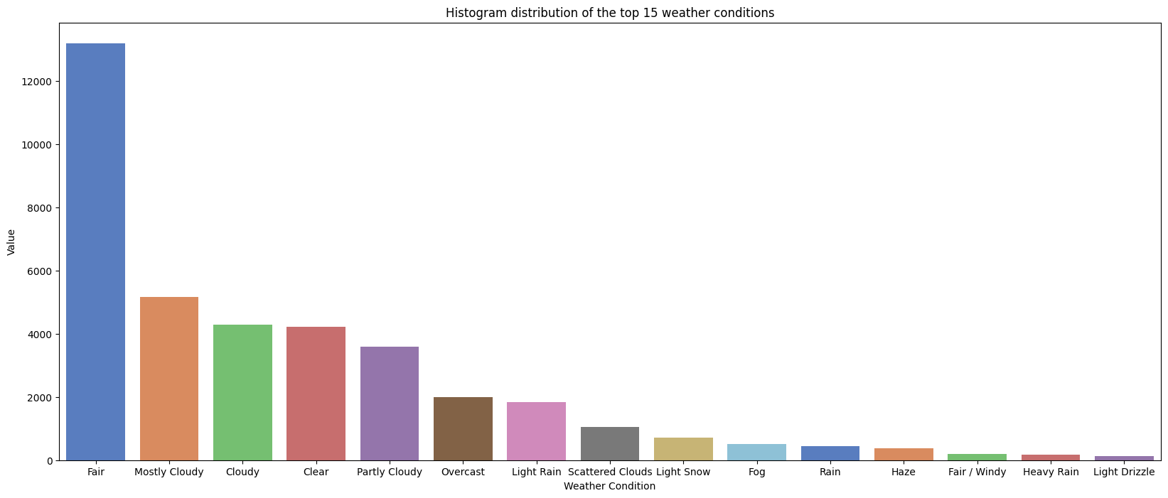
STATISTICS

Slide 6
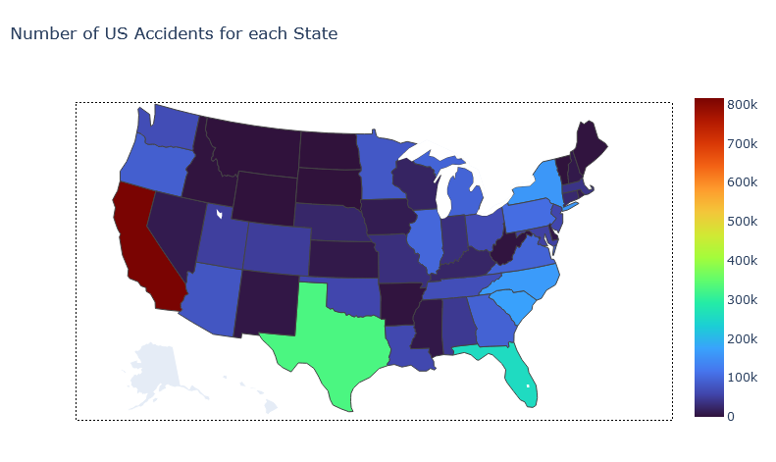
STATISTICS

Slide 7
Features in the dataset
Severity
Start_Latitude
Start_Longitude
City
Temperature(F)
Humidity(%)
Pressure(Pa)
Visibility(mi)
Wind_Direction
Wind_Speed(mph)
Precipitation(in)
Weather_Condition
Amenity
Bump
Crossing
Give_Way
Junction
No_Exit
Railway
Roundabout
Station
Stop
Traffic_Calming
Traffic_Signal
Civil_Twilight
Year
Month
Weekday
Day

Slide 8
METHODOLOGY We will be using an MLP classifier(Multilayer Peceptron) which is basically an artificial neural network, using 3 layers.
The outer layer has a neuron size of 30, which corresponds to the number of features in the dataset.
The first hidden layer has 16 neurons
The second hidden layer has 8 neurons
The final layer has 1 neuron
The main activation function is ReLU(Rectified Linear Unit)
The final neuron activation function is Limited-memory BFGS
Limited-memory BFGS (L-BFGS or LM-BFGS) is an optimization algorithm in the family of quasi-Newton methods that approximates the Broyden–Fletcher–Goldfarb–Shanno algorithm (BFGS) using a limited amount of computer memory. It is a popular algorithm for parameter estimation in machine learning.

Slide 9
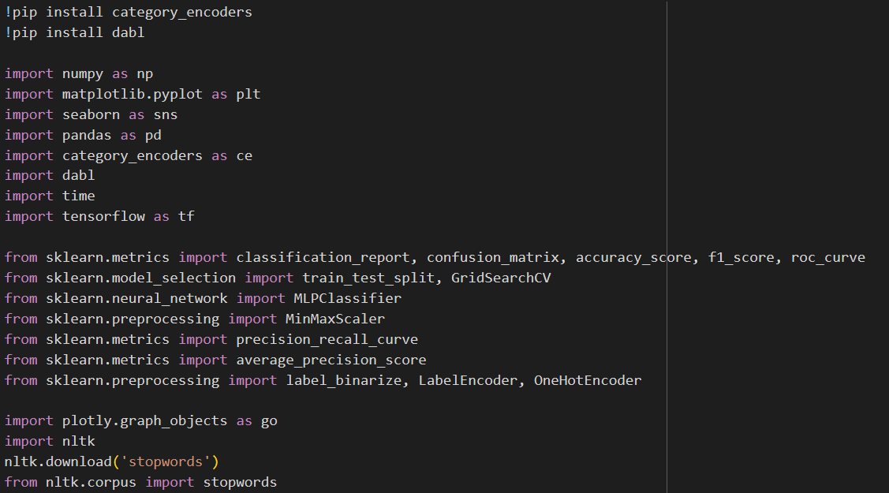
Code - Importing all the necessary libraries

Slide 10
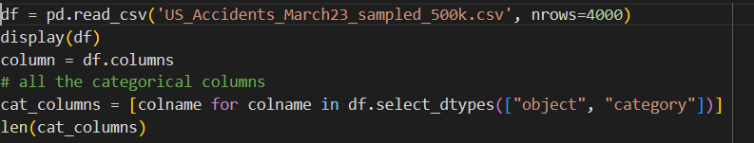
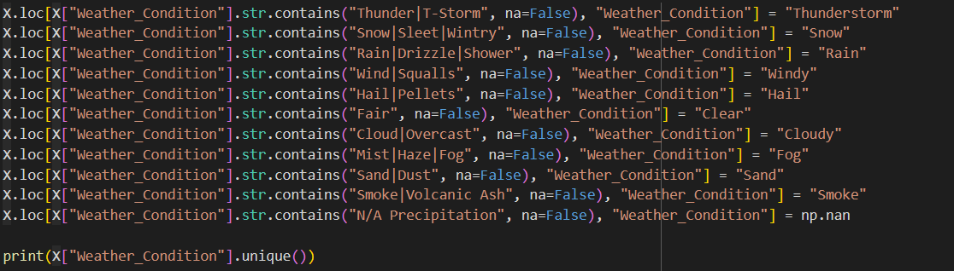
Importing the dataset and reducing categorical data

Slide 11
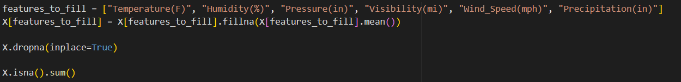
Filling missing value in features

Slide 12
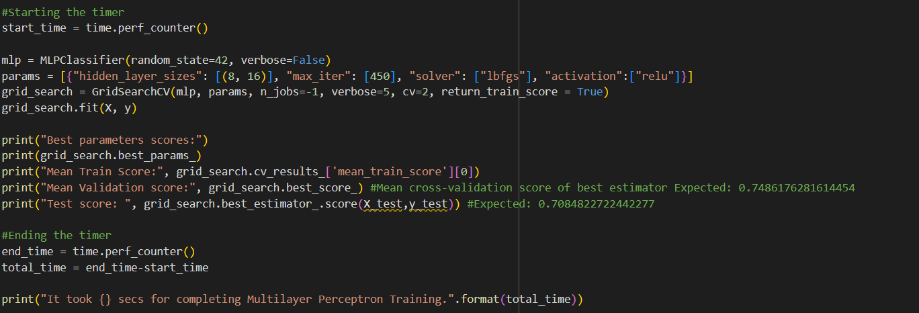
ANN Model

Slide 13
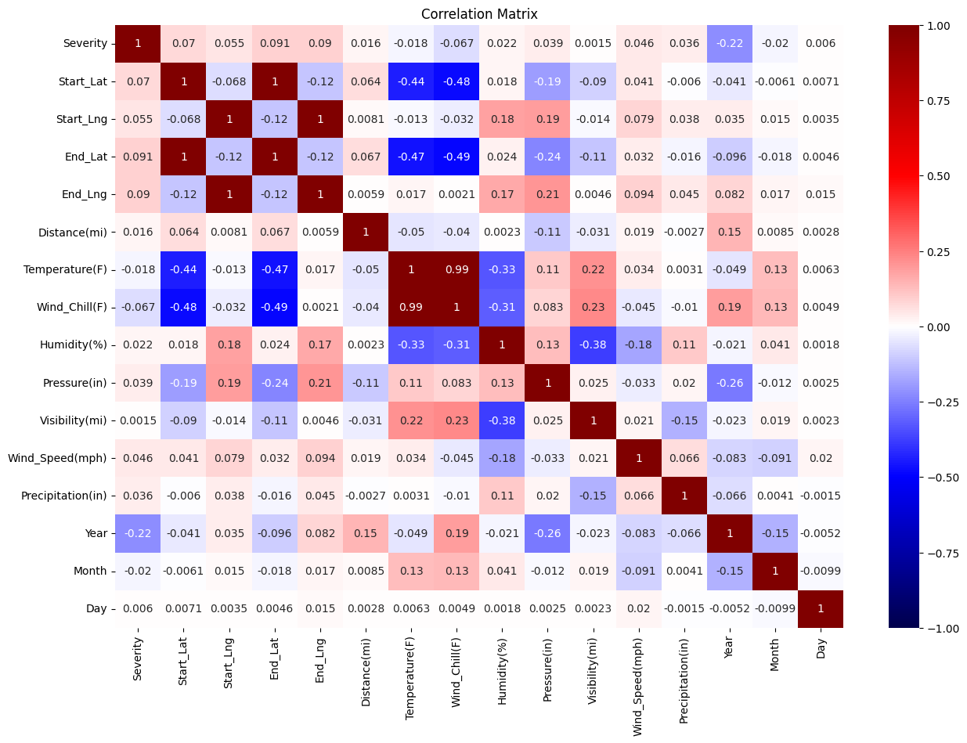

Slide 14
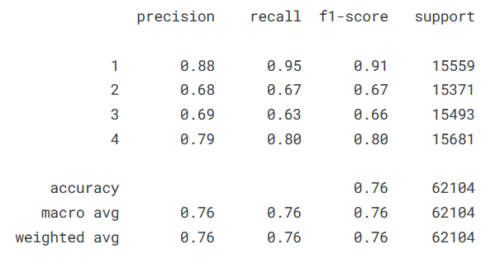
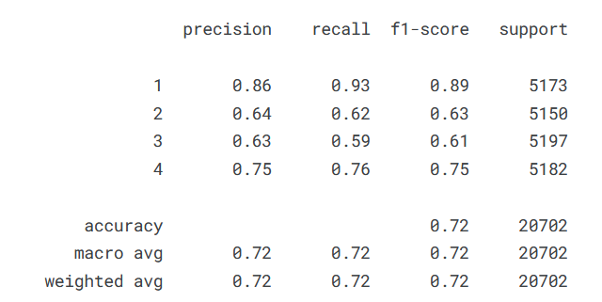
RESULTS AND DISCUSSION
Metrics on TRAIN Dataset
Metrics on TEST Dataset

Slide 15
PRECISION - Precision is a term used in machine learning to describe the accuracy of a model. It is defined as the number of true positives divided by the sum of true positives and false positives
RECALL - The recall is calculated as the ratio between the numbers of Positive samples correctly classified as Positive to the total number of Positive samples.
F1 SCORE - The F-score, also called the F1-score, is a measure of a model’s accuracy on a dataset. It is used to evaluate binary classification systems, which classify examples into ‘positive’ or ‘negative’.
SUPPORT - In the context of ANNs, support refers to the connections and interactions between units (neurons) within the network.

Slide 16
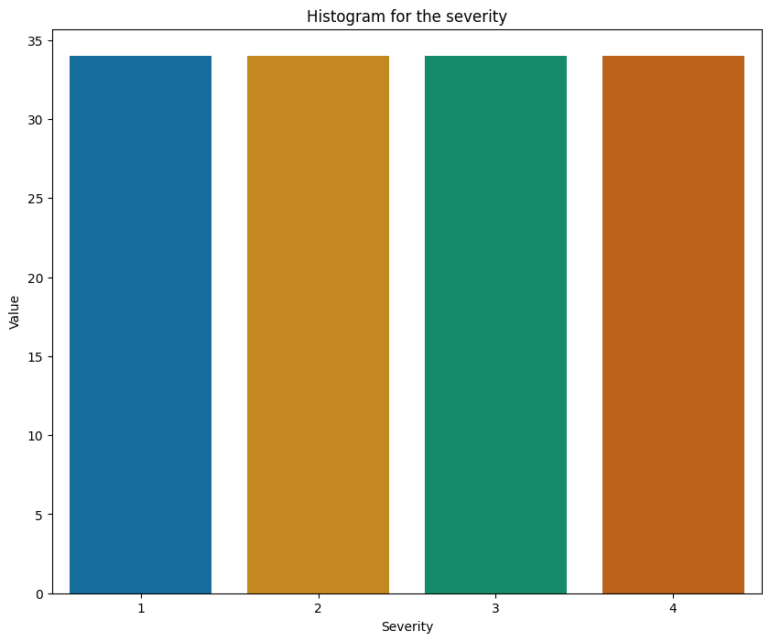
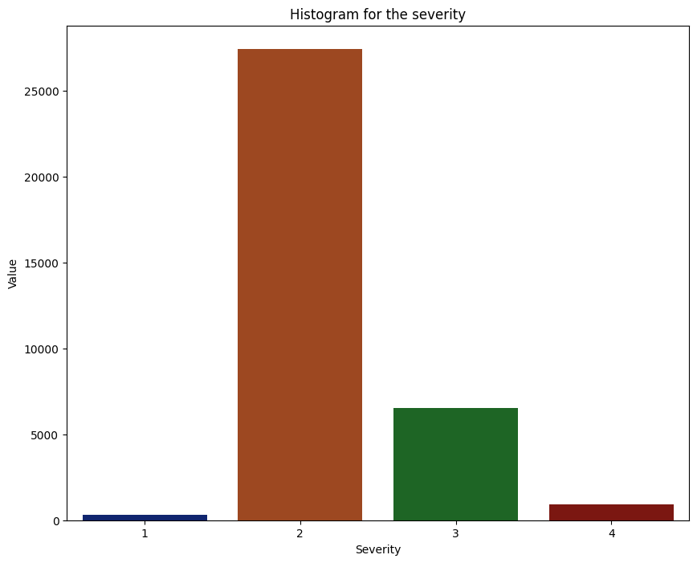
HISTOGRAMS -

Slide 17
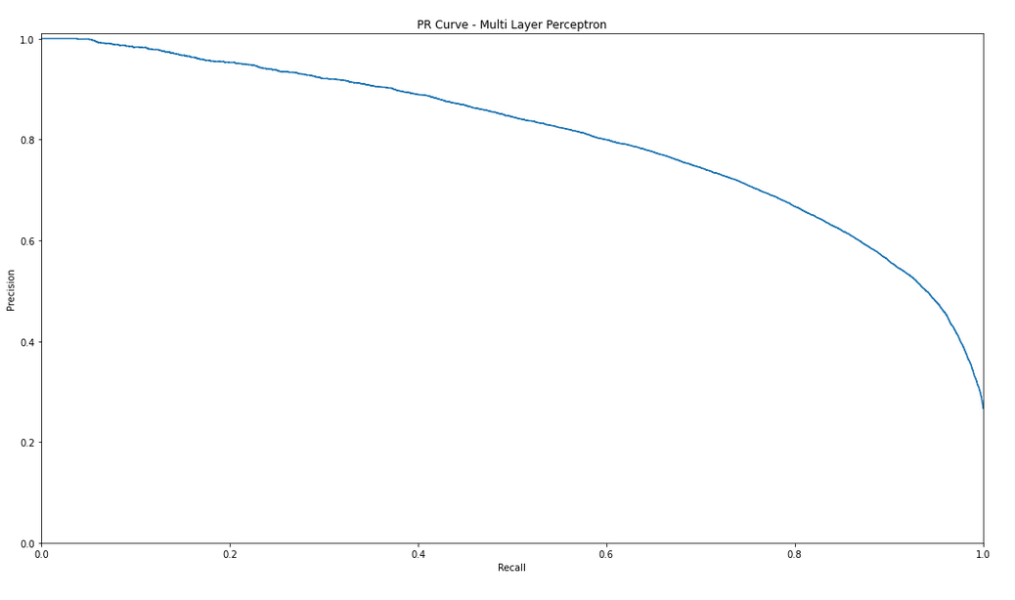
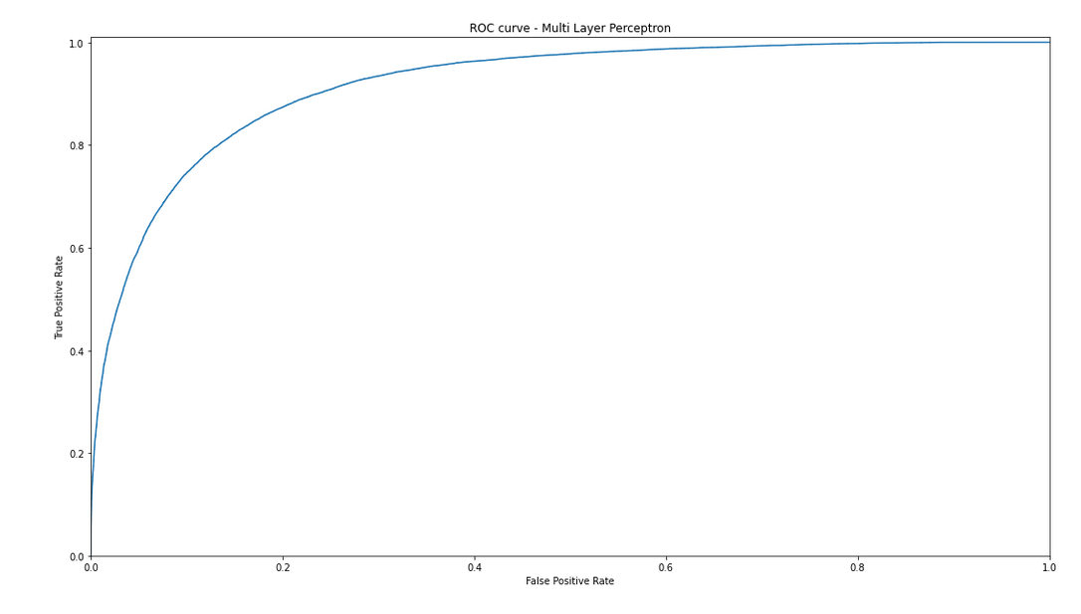

Slide 18
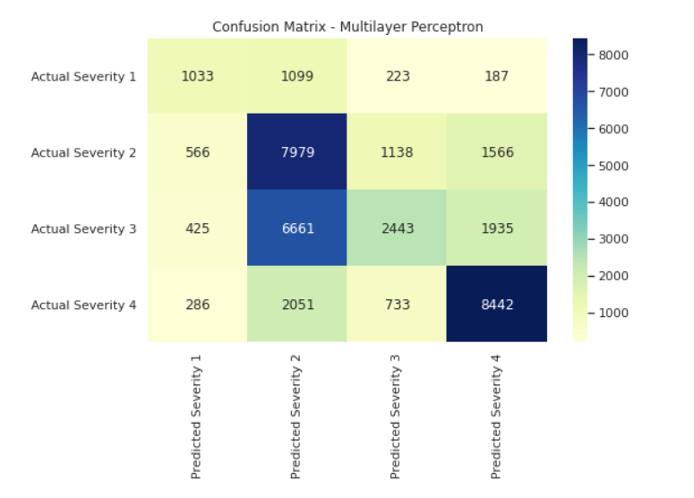

Slide 19
CONCLUSIONS 1. Dataset Overview:
Source: The dataset encompasses US accidents from 2016 to 2023 and can be obtained from Kaggle.
Attributes: The dataset likely includes various attributes such as location (latitude and longitude), time of accident, weather conditions, road conditions, severity of accidents, and possibly contributing factors like visibility and traffic congestion.
2. Importance and Utility:
Understanding Accident Trends: EDA can reveal trends in accident frequency over time, seasonal variations, and any notable spikes or decreases.
Identifying High-Risk Areas: Analysis of accident locations can help identify regions with a high frequency of accidents, assisting authorities in implementing targeted safety measures.
Examining Contributing Factors: By exploring variables such as weather conditions, road conditions, and time of day, insights can be gained into factors contributing to accidents.
3. Potential Applications:
Predictive Modeling: Insights from EDA can be used to develop predictive models to forecast accident occurrence and severity, aiding in proactive risk mitigation.
Safety Interventions: Understanding the factors influencing accidents can guide the implementation of safety interventions such as improved road maintenance, enhanced signage, and targeted enforcement strategies.
Policy Decision Support: Policymakers can utilize EDA findings to inform decisions related to transportation infrastructure investments and regulations aimed at improving road safety.

Slide 20
In this analysis, we delved into the comprehensive dataset of US traffic accidents spanning from 2016 to 2023 to gain insights into the patterns, trends, and factors influencing road safety. Through exploratory data analysis and visualization, we uncovered valuable insights that shed light on various aspects of road safety dynamics.
We identified geographical hotspots of accidents, temporal patterns in accident occurrence, and correlations between weather conditions, road features, and accident severity. By leveraging advanced analytical techniques and visualization tools, we gained a deeper understanding of the multifaceted nature of road safety challenges.
Furthermore, we outlined potential avenues for future research and action, including the integration of additional data sources, development of advanced predictive models, and implementation of targeted interventions aimed at promoting safer driving behaviors and reducing accident rates.
Ultimately, this analysis serves as a foundation for informed decision-making, policy formulation, and community engagement initiatives aimed at improving road safety outcomes and creating safer transportation systems for all road users. By continuing to explore and address road safety challenges collaboratively, we can work towards our shared goal of achieving zero preventable accidents and ensuring safe mobility for everyone.

Slide 21
THANK YOU

